Slide 1

Health Odyssey
Zeynep Zor 31264
Data Science For Good Health

Slide 2

MY MOTIVATION
My main purpose and motivation for carrying out this project is to understand whether university benefits my health.

Slide 3

MY HYPOTHESIS
Starting Sabancı University positively affected my health

Slide 4

DATASET SOURCES
My Own Health Application

Slide 5
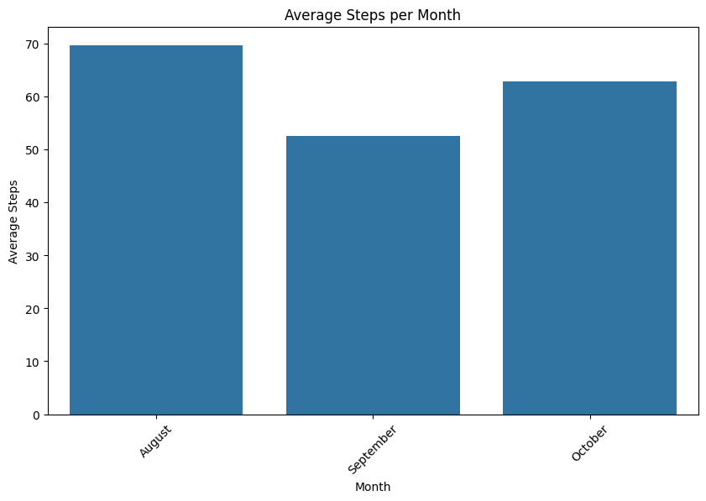
TECHNIQUES
Data Processing
Excel Processing
Data Transformation
Data Visualization
Graph Customization
Data Labels
Bar Chart
Twin Axes
Axis Labeling
Graph Display
Data Extraction
Data Sorting
Label Customization

Slide 6
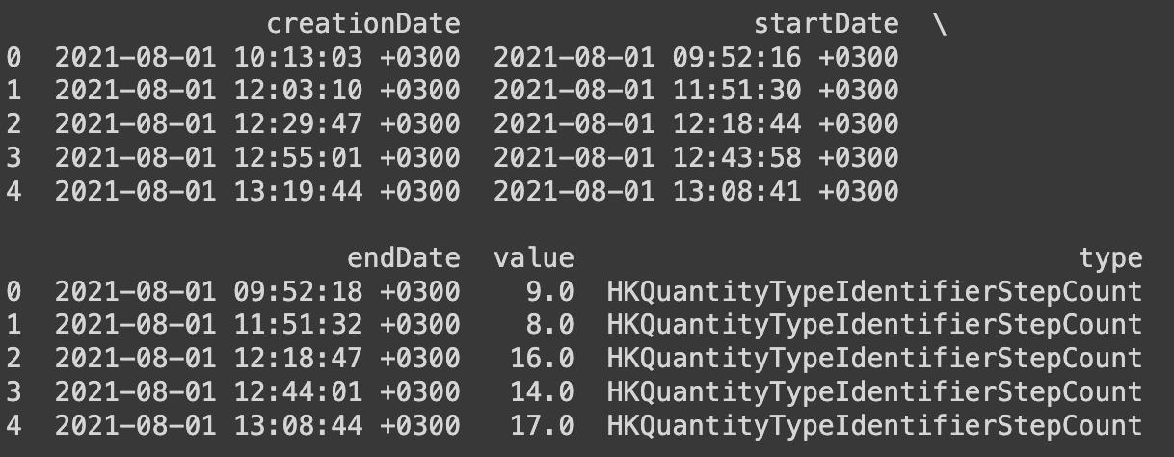
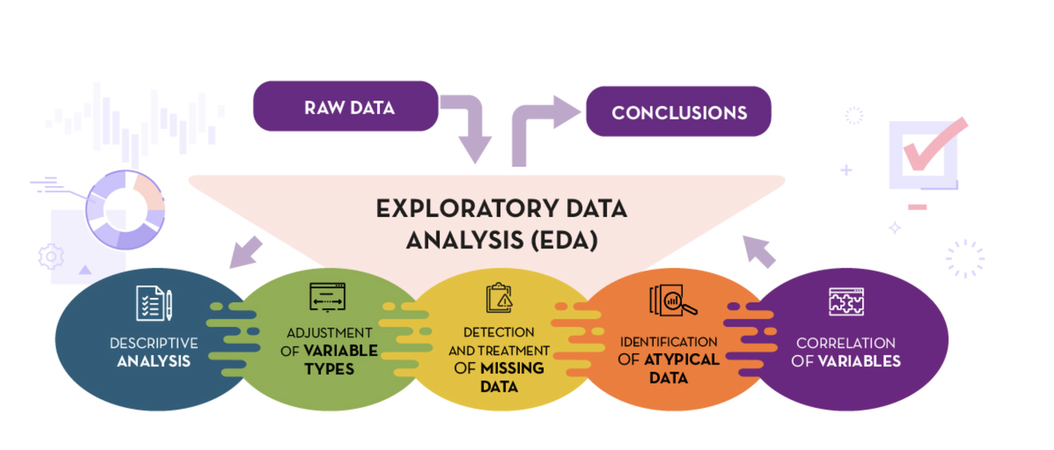
EDA

Slide 7
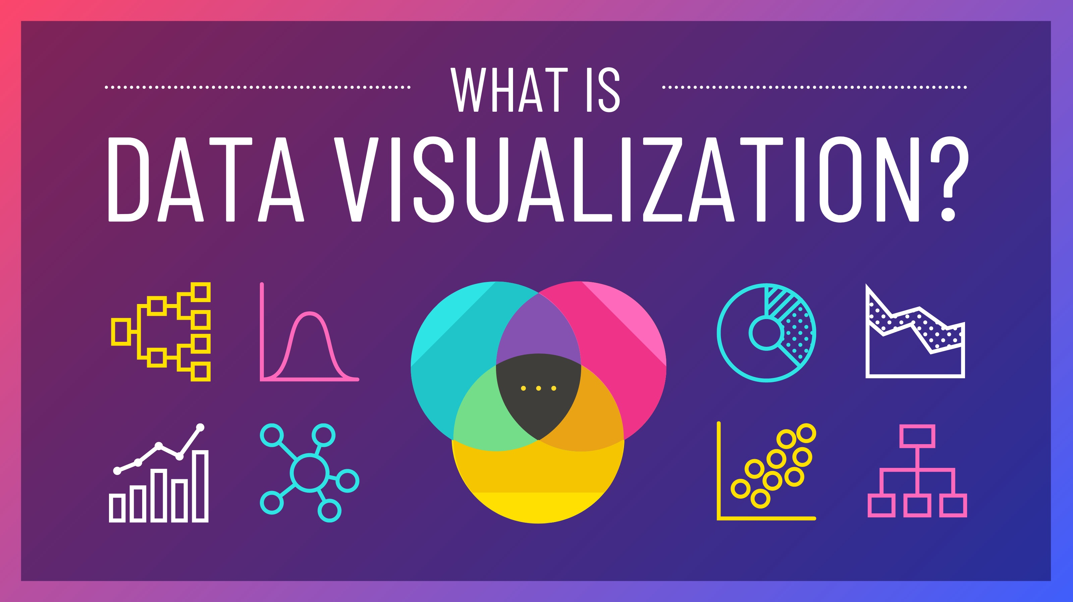
VISUALISATION

Slide 8
BAR CHART

Slide 9
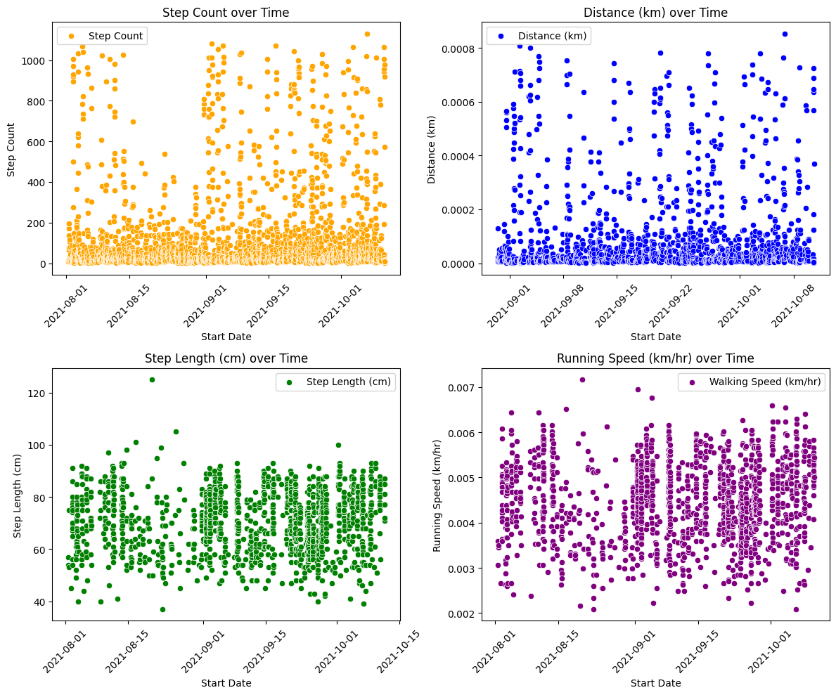
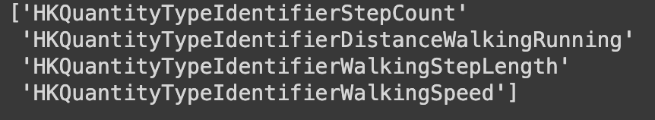
Scatter Plot about my selected data in my health app

Slide 10
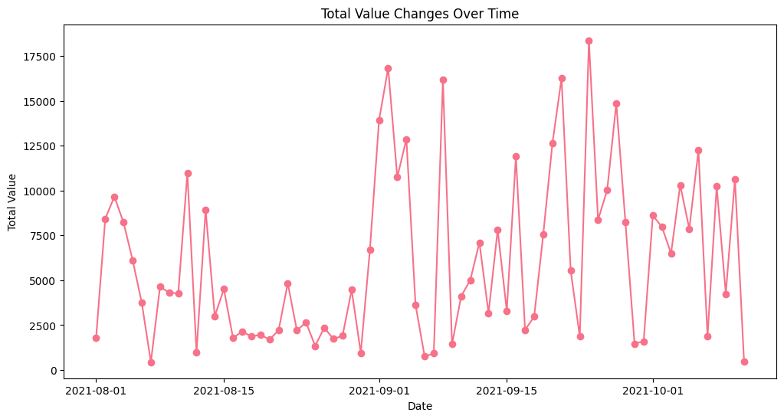

Slide 11
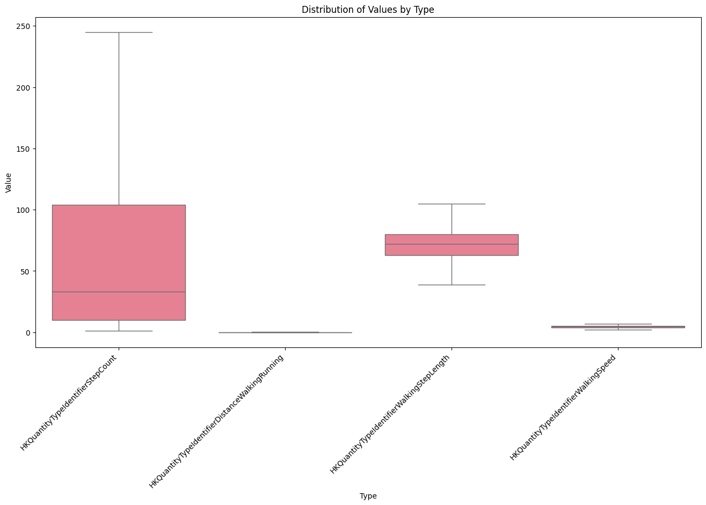

Slide 12

HYPOTHESIS TESTING
Null Hypothesis: Starting Sabancı University positively affected health.
Alternative Hypothesis: No significant evidence that Starting Sabancı University positively affected health.
Result: The statistical analysis indicates that there is no significant evidence to reject the Null Hypothesis. Therefore, based on the available data, there is no indication that starting Sabancı University positively affected health.

Slide 13
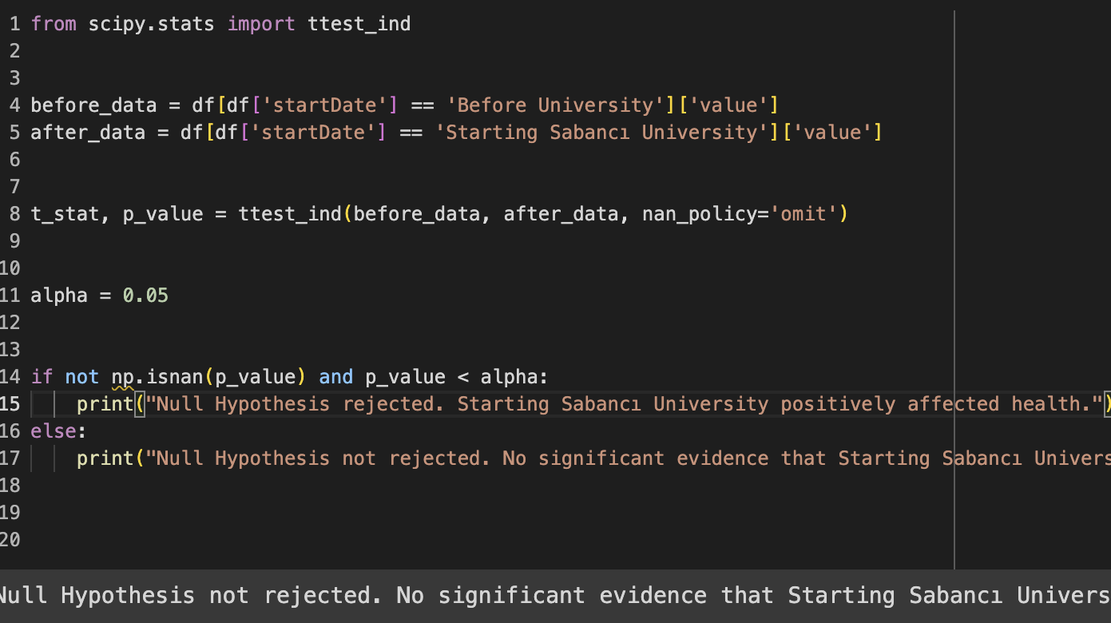

Slide 14
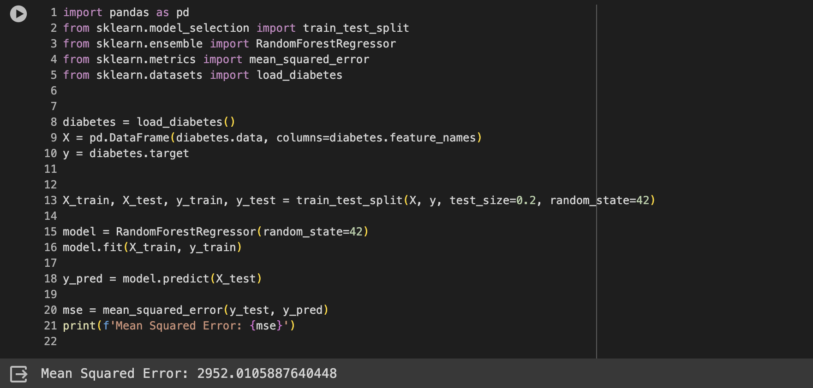
MACHINE LEARNİNG
MSE (Mean Squared Error) is a metric used to evaluate the predictive performance of a regression model. It is especially used to measure the differences between actual and predicted values.

Slide 15
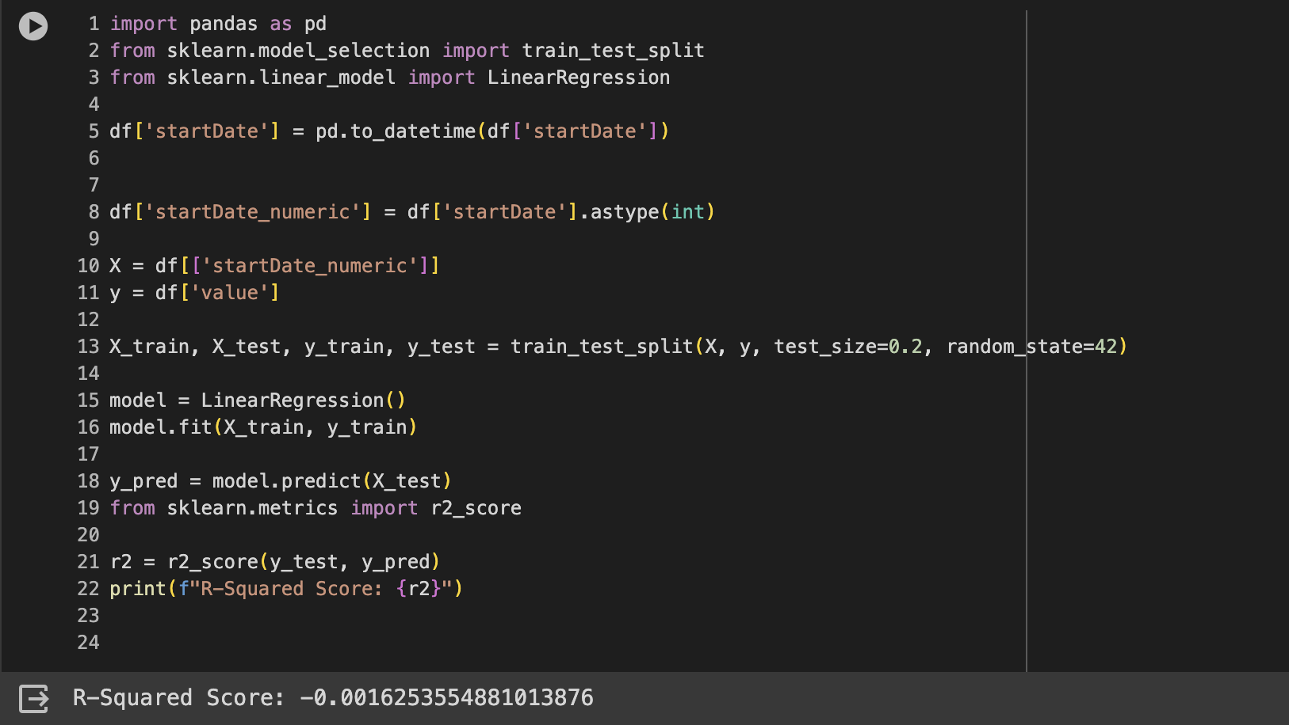

Slide 16
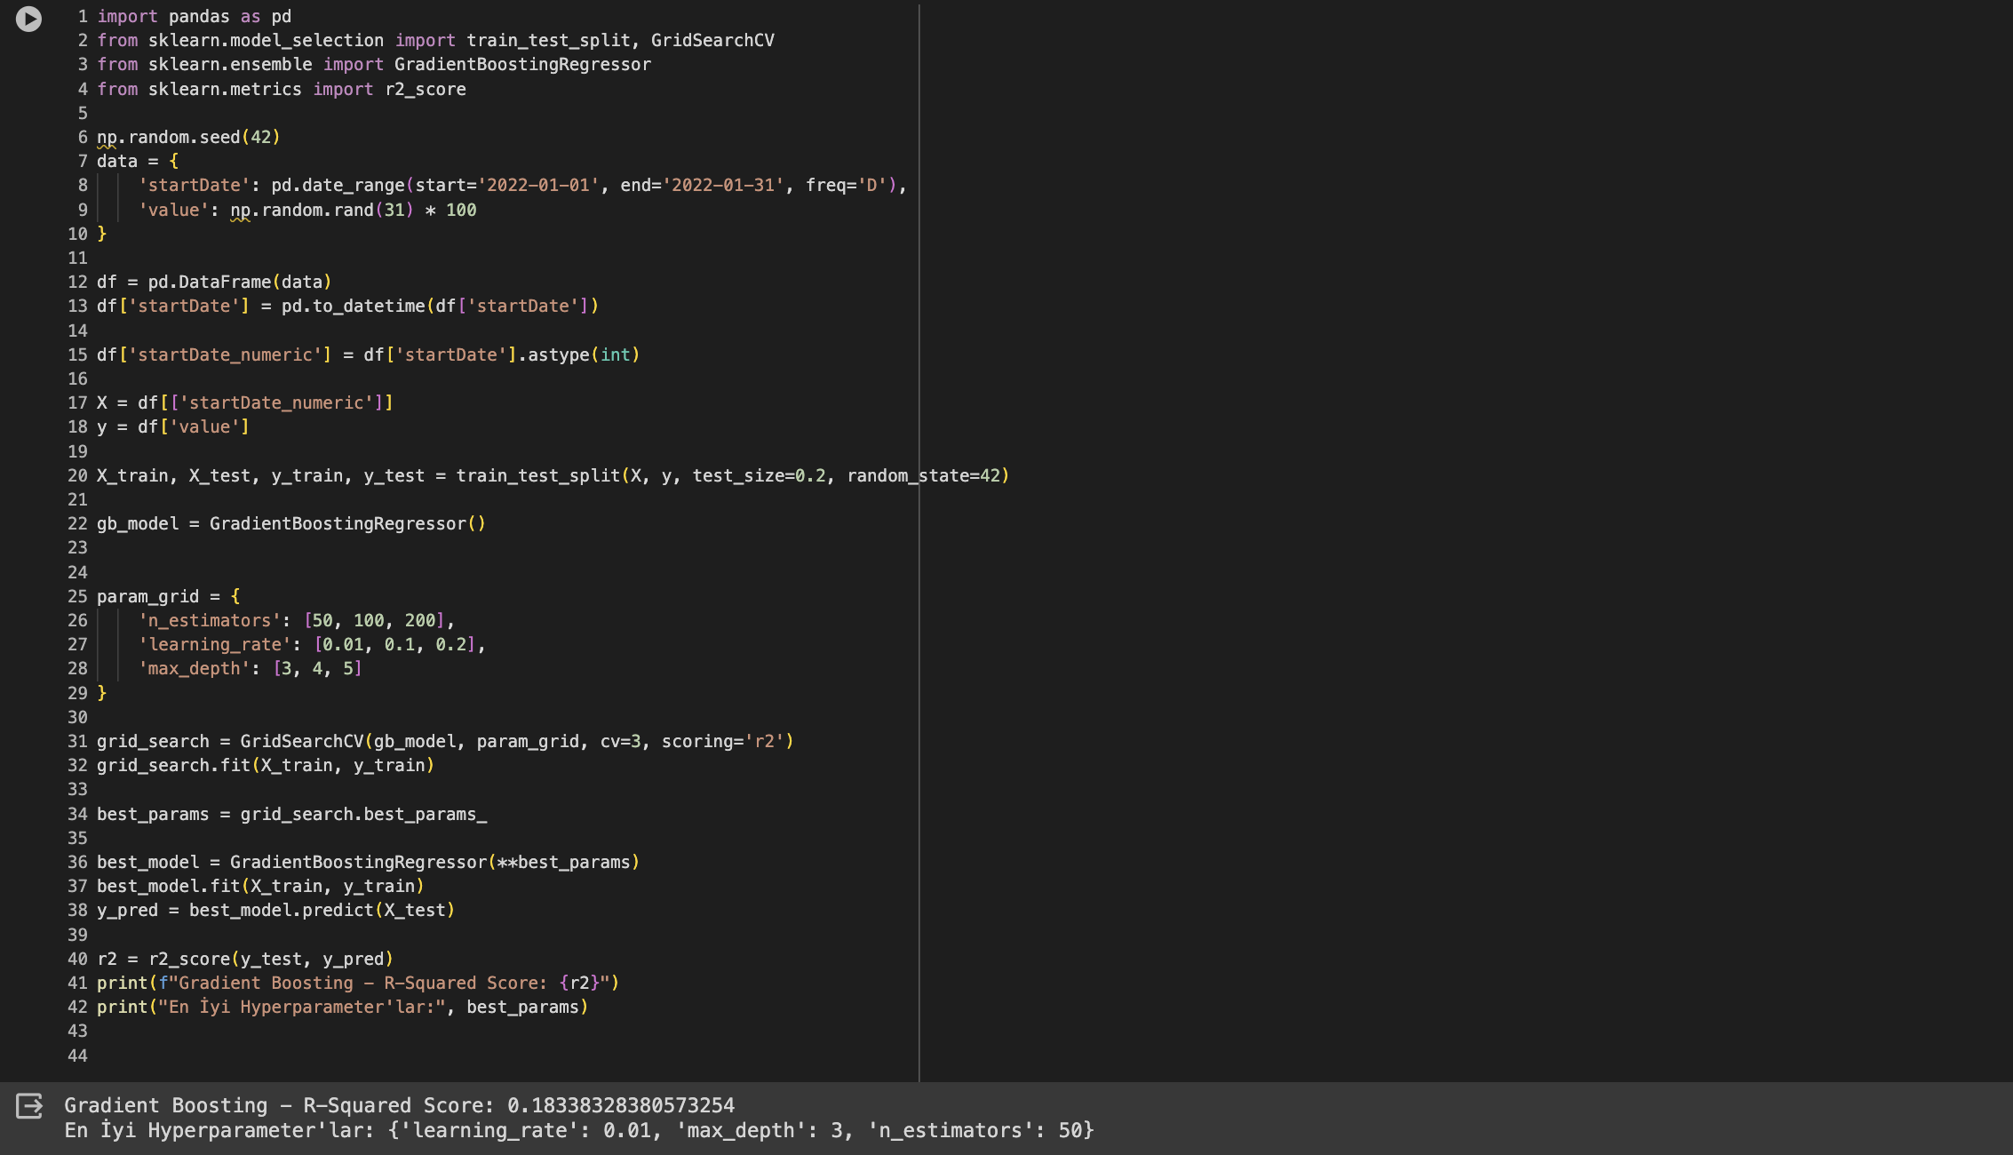

Slide 17
SUMMARY
Topic Selection
Data Collection
Data Visualization
Tables
Hypothesis Testing
Reject or not Reject the decision

Slide 18

THANK YOU FOR LISTENİNG!!

